Slide 1
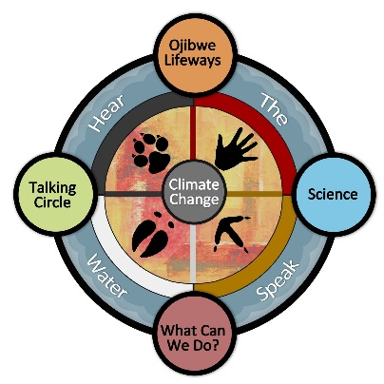
Do Culture and Science Agree?
Making Climate Change “Come Alive”
Using the G-WOW Climate Literacy Model
IASNR Conference, June 3 2019
Cathy Techtmann- Environmental Outreach State Specialist
Professor, Community Resource Development

Slide 2
DISCLAIMER
This is a polar bear free program
The communication framework, demonstrated through the
G-WOW Climate Literacy Model, can help you create effective climate messaging
that resonates with audiences and promotes action

Slide 3
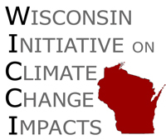
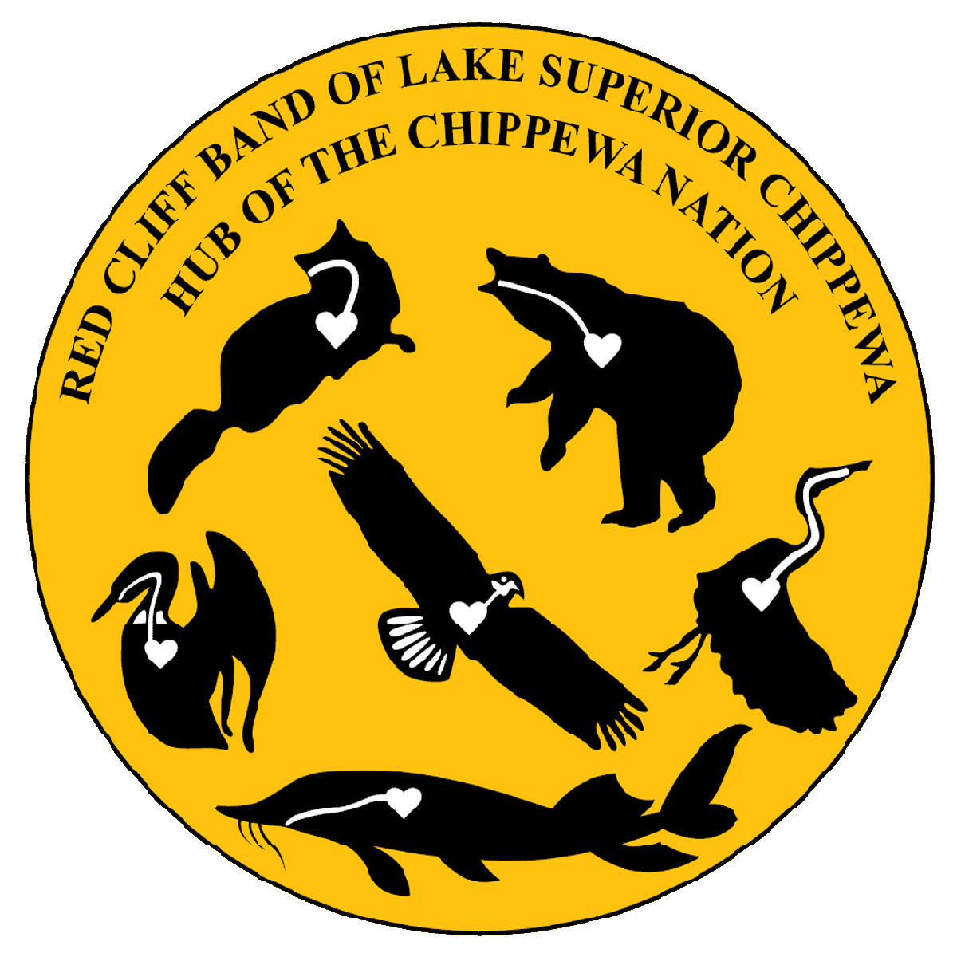
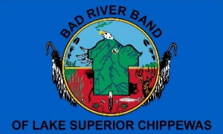
Project Partners
Additional support

Slide 4
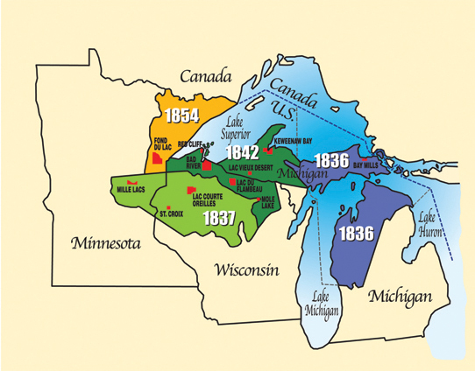
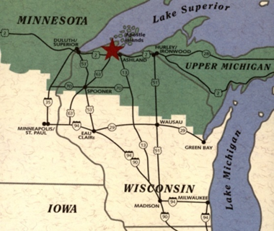
Project Development
In the heart of the Lake Superior Chippewa (Ojibwe) Indian Country. This region includes the 11 Ojibwe Tribes living within the “Ceded Territory”
Project developed in the Wisconsin’s Lake Superior region– but applicable to all cultures & locations

Slide 5
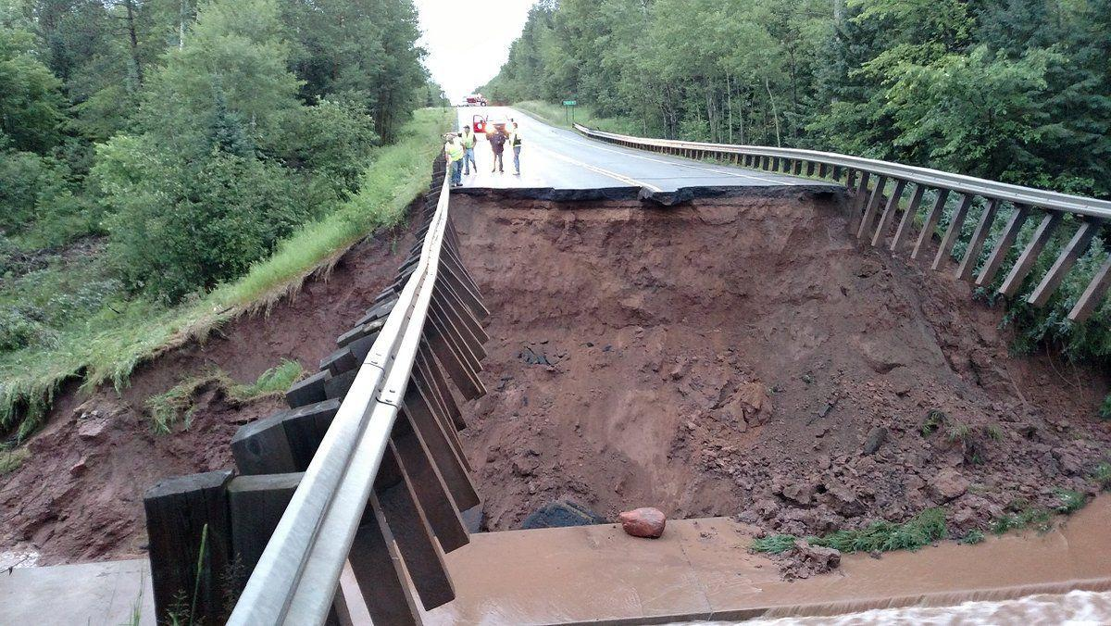
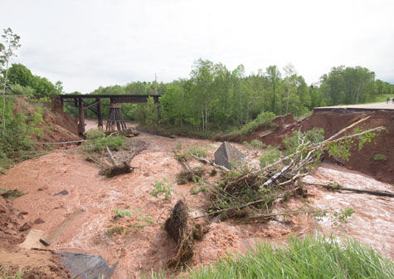
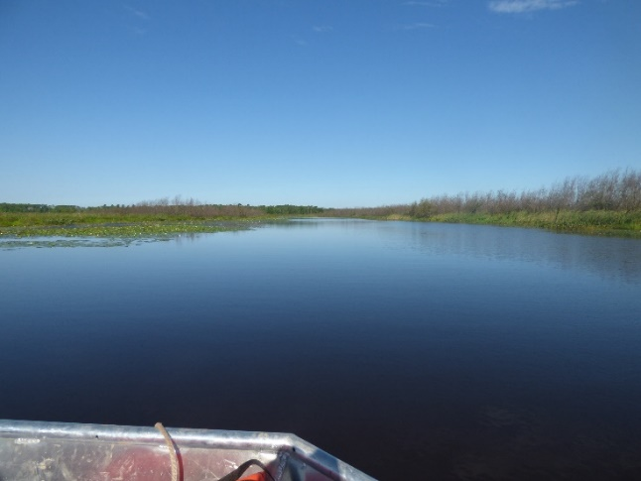
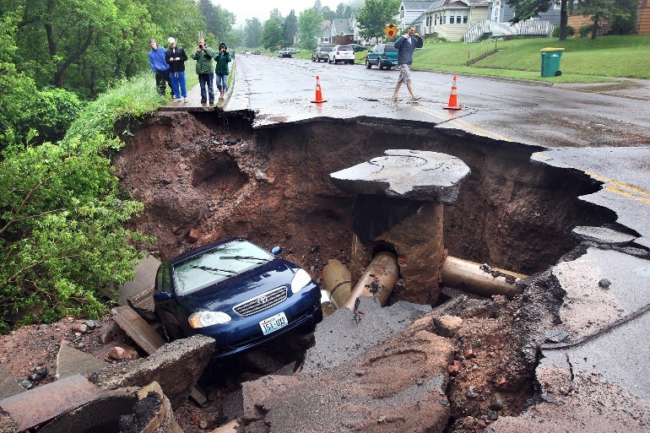
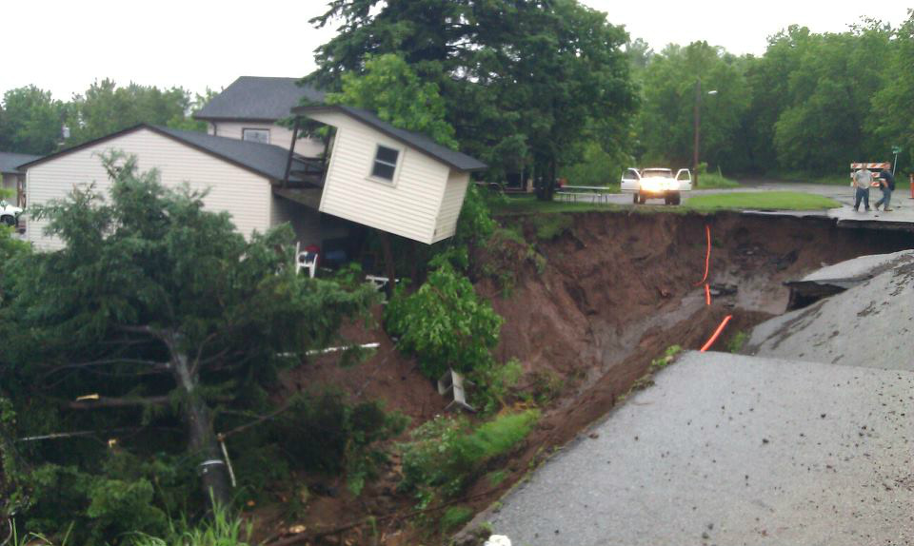
Project Roots
Increasing evidence that climate change is affecting safety on public lands and communities
Climate change was affecting species & habitats that support Ojibwe treaty rights
2016
2018
2015
2014
Loss of wild rice
Kakagon Sloughs of the Bad River Ojibwe
Increase in extreme storm events

Slide 6
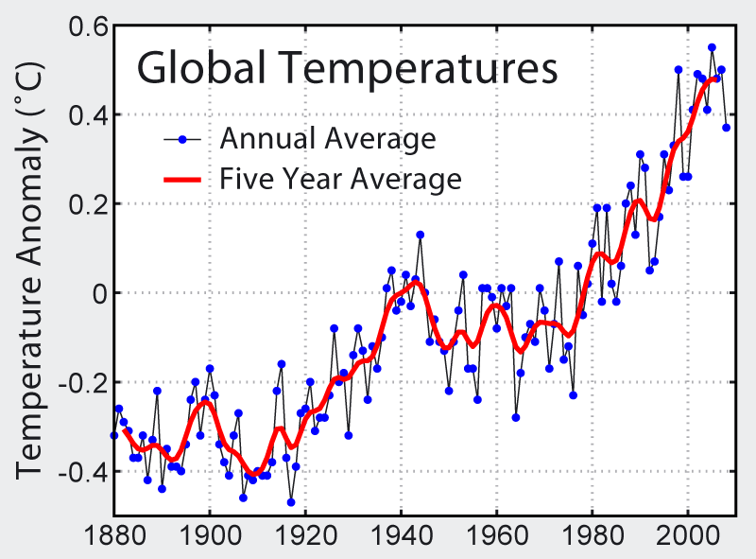
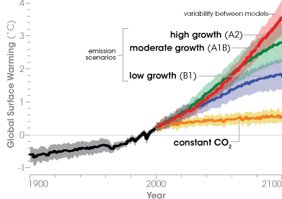
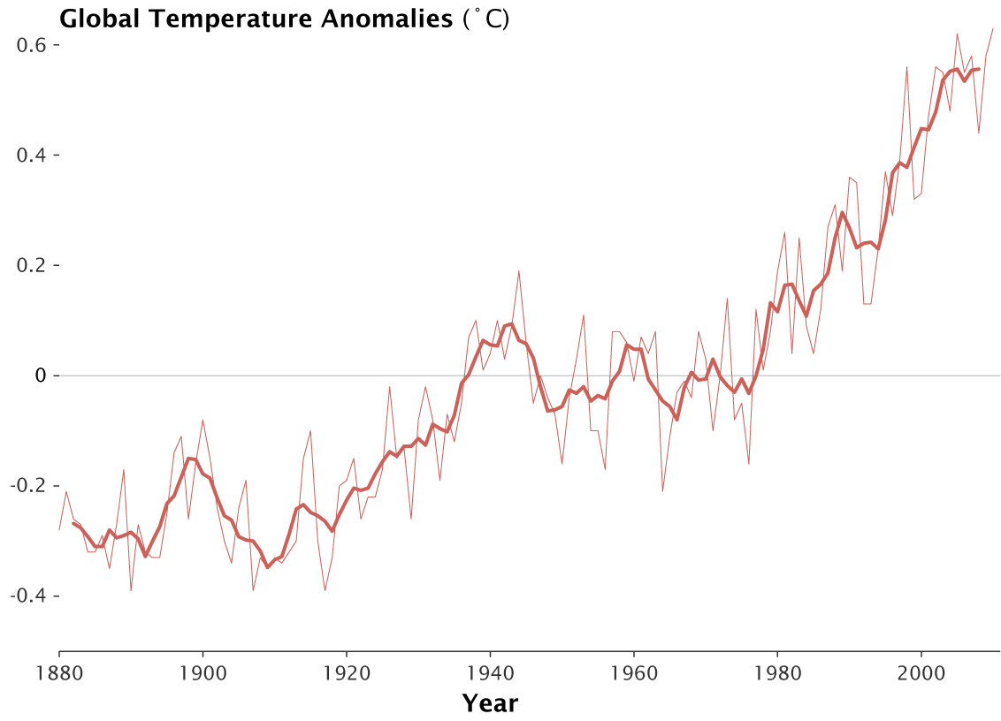
“Traditional” climate literacy approaches were not resonating with audiences

Slide 7
Our Goal
Create a climate literacy “model” that increases people’s awareness of climate change so they want to
do something about it!
The Result
Gikinoo’wizhiwe Onji Waaban (Guiding for Tomorrow)
or “G-WOW” Climate Literacy Model

Slide 8
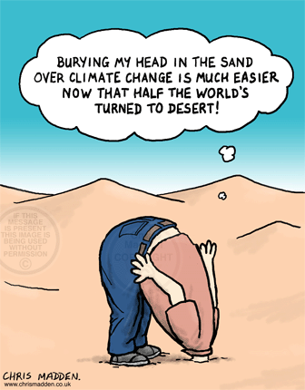
What’s Different About the G-WOW Climate Literacy Model?
1. It’s research based
“…local, place-based evidence of climate change gained through experiential learning is as, or more effective than, simply studying analytical climate change data to increasing climate change literacy.”
“The Psychology of Climate Change Communication”, Columbia University 2009

Slide 9
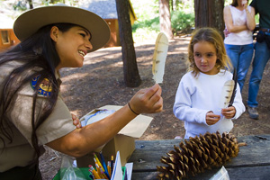
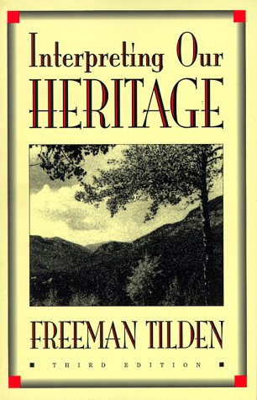
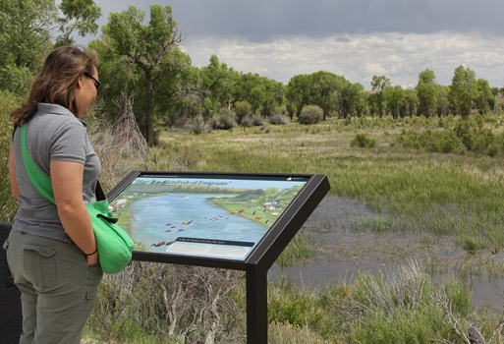
2. It uses an Interpretative Communication Framework
Interpretation is….
A highly effective style of communication that can make a topic or object “come alive” by revealing meanings and relationships to an audience
Can be used in any field or discipline, in many different formats
including science communication!

Slide 10
Revelation of
Deeper meanings
Relationships
Connections
Action
Instead of Translation of Facts
aka “Tech Transfer”
Through climate interpretation, understanding; through understanding, awareness, through awareness, climate action
G-WOW Model
“Through interpretation, understanding; through understanding, appreciation; through appreciation, protection”
- Freeman Tilden-

Slide 11
Interpretive Communication includes ALL of these principles
(and so can your climate change communication)

Slide 12
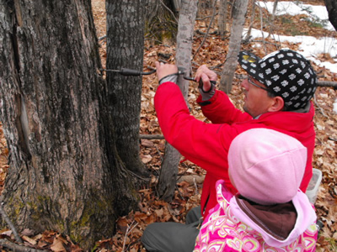
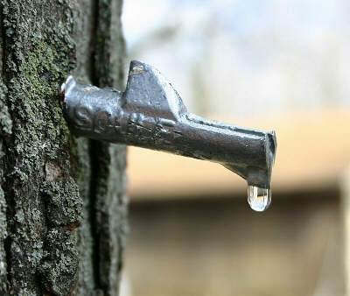
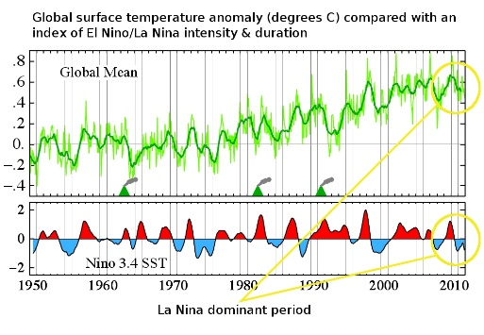
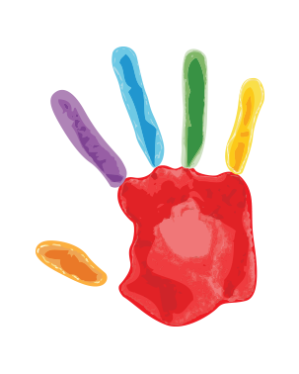
Relate
Must relate to a person’s experiences, values
Provoke
Calls for action—
The Big So What!
Reveal
Revelation of information
rather than just “tech transfer”
Tell the “Whole”
Not just the parts

Slide 13
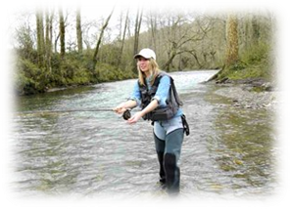
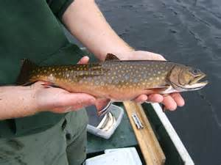
3. It links climate change to what people value through the sustainability of species and habitats
By revealing how climate change is affecting the
sustainability of species and habitats
that support cultural or economic practices people value
by integrating
place-based evidence they can observe
with climate science
to provoke action

Slide 14
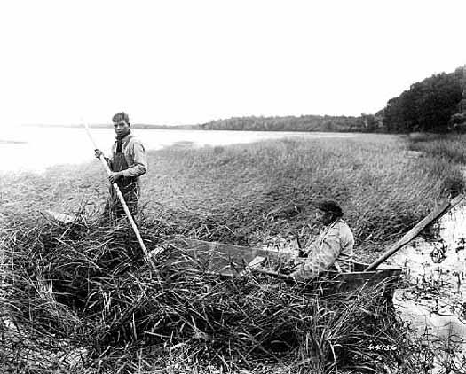
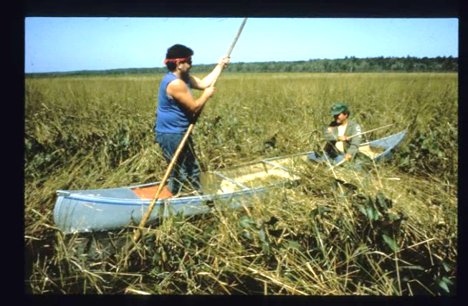
4. It integrates Traditional Ecological Knowledge (TEK)
Why?
The Lake Superior Ojibwe have relied on the sustainability of
plant and animal species for generations to support subsistence, cultural, and spiritual practices or “lifeways”……

Slide 15
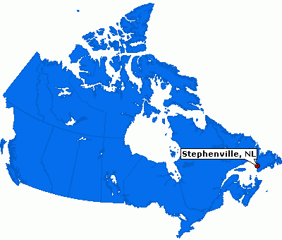
……..Indigenous traditional ecological knowledge (TEK)
of natural systems, and language provide long term place-based indicators of climate change beyond weather variability. These can provide us with a “baseline” for evaluating place-based evidence we are observing in other cultures
Challenges with Place-Based Evidence
“Survey results confirm that residents perceive regional climate change, it is not clear whether (they) can distinguish (weather) variability from climate change”
Finnis, J., Sarkar, A., Stoddart, M. 2015. Bridging science and community knowledge? The complicating role of natural variability in perceptions of climate change. Global Environmental Change 32: 1-10.

Slide 16
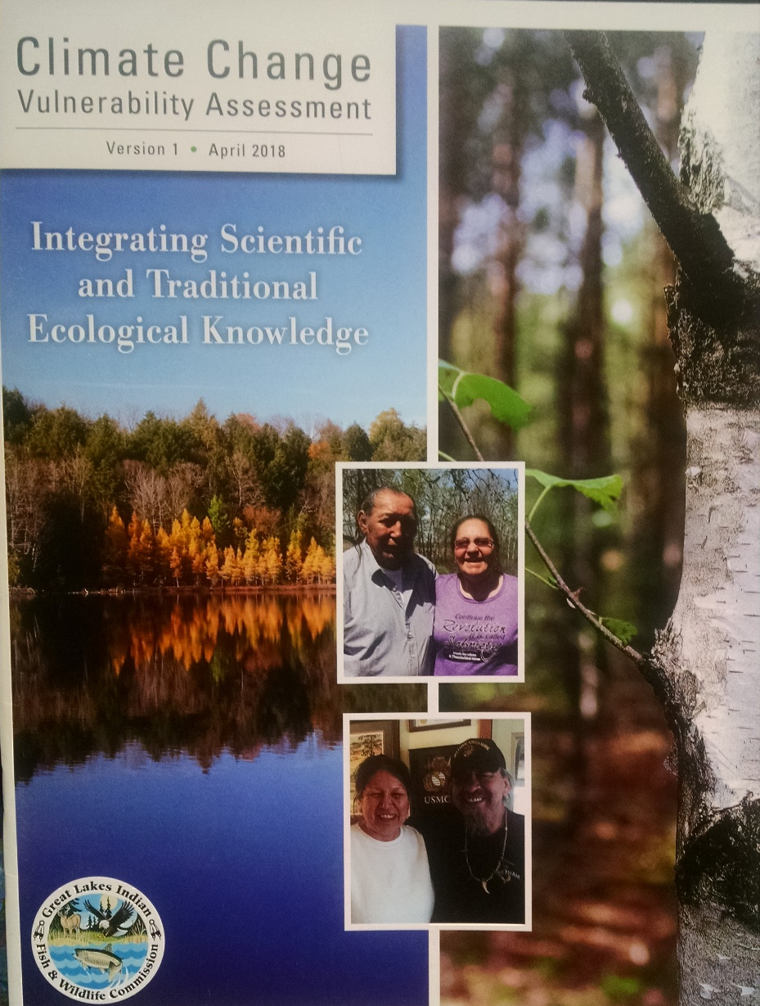
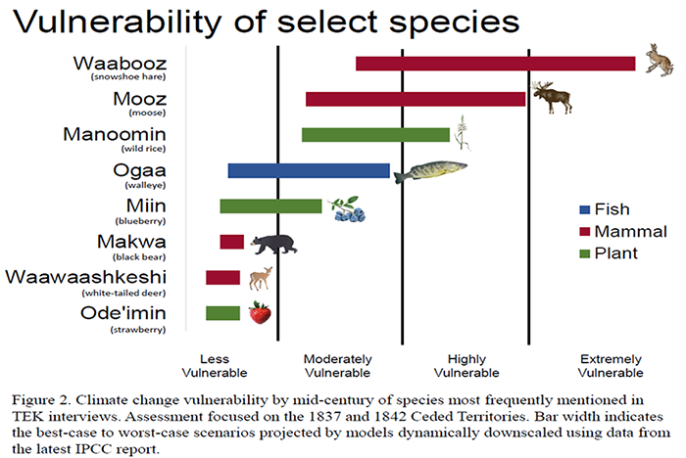
Sources of Traditional Ecological Knowledge
Great Lakes Indian Fish and Wildlife Commission’s
“Climate Change Vulnerability Assessment”
Language Knowledge Keepers Elders

Slide 17
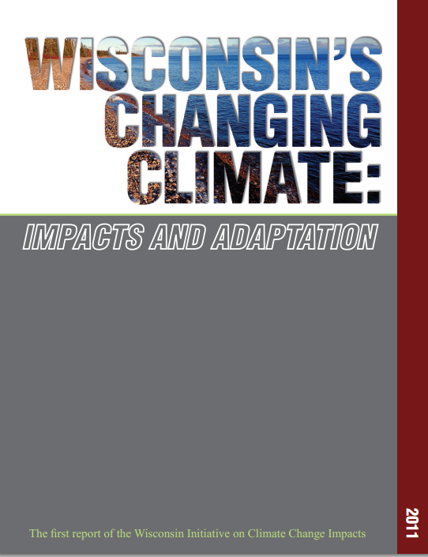
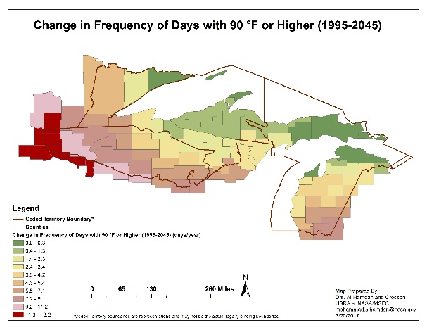
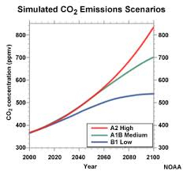
Qualitative place-based evidence is integrated with
quantitative evidence from peer reviewed sources
Historic climate data and projections in map formats
NASA
WICCI
The A1B climate scenario (middle of the road) is used in climate projections unless otherwise stated

Slide 18
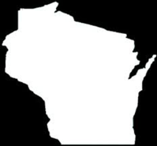
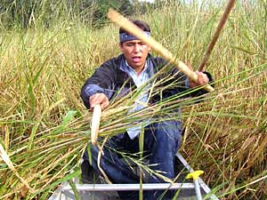
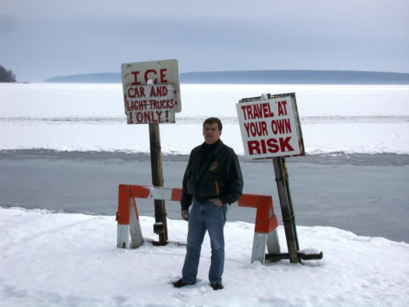
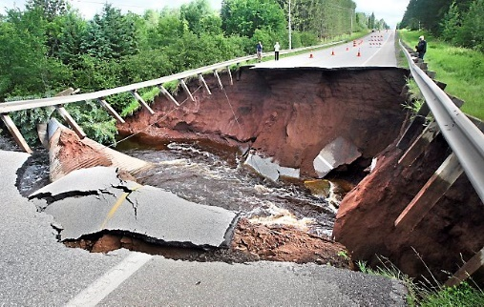
Place-based Evidence- qualitative evidence we can observe
Unprecedented cancellation/disruption of tribal wild rice harvests based on TEK
Ice cover on Lake Superior at Bayfield, Wisconsin has decreased approximately 3 days/decade or 45 days over the past 150 years
More extreme storm events: 2012, 2014, 2015, 2016, 2018

Slide 19
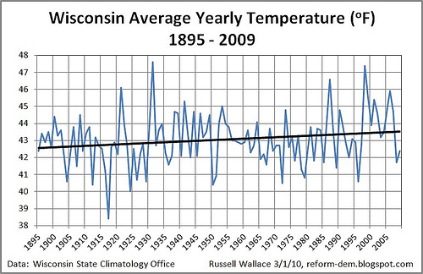
Quantitative evidence… from historic measurements & climate models
From 1950-2006
+1ºF over all temperature increase
+2 - 2.5ºF increase in NW Wisconsin

Slide 20
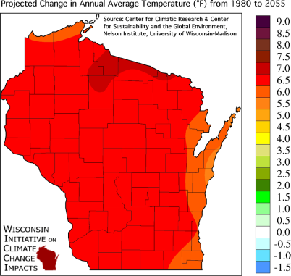
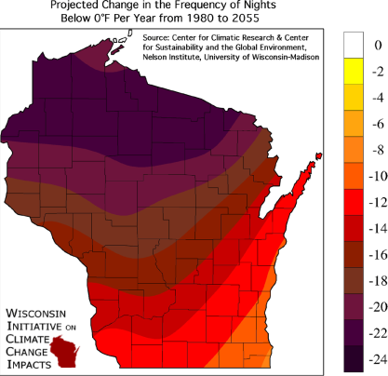
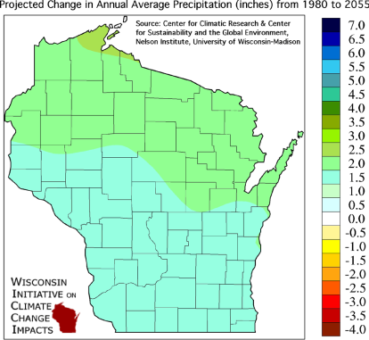
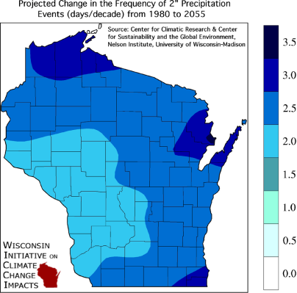
WHAT’S IN THE FUTURE?
PROJECTIONS (1980-2055)
Based on A1B scenario
OVERALL WARMING
Change in Average Annual Temps +4-9ºF
WARMER WINTERS
Decrease in Frequency of Cold Nights-
esp. Northern Wisconsin
MORE EXTREME WEATHER
Up to 4.5 inch annual mean increase in precip
25% increase in the frequency of 2-inch or greater rainfall events

Slide 21
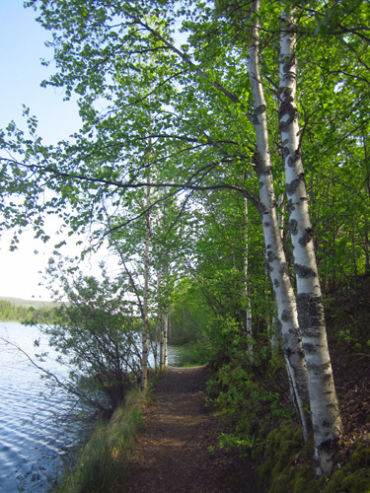
CLIMATE WINNERS & LOSERS
Environmental variables that affect habitat conditions include:
Temperature
Precipitation
Drought
Intense storm events
Change in environmental variables will affect the habitat conditions that plants and animals depend on to thrive and survive
We depend on the sustainability of these species & habitats for
supporting our cultures and economies

Slide 22
The G-WOW Climate Framework
Cultural/Economic Practice
Species/Habitat
TEK, Place-based and Scientific Evidence
What species or habitat conditions are needed to
support this practice?
What changes are you observing in the cultural practice, key species, or the habitat?
A cultural or economic practice you value
How are environmental variables critical to supporting the habitat conditions projected to change based on climate science? Variables may include: temperature, precipitation, drought, intense rain/ storms, humidity, etc.
If a species, what habitat conditions does it need to survive and thrive?

Slide 23
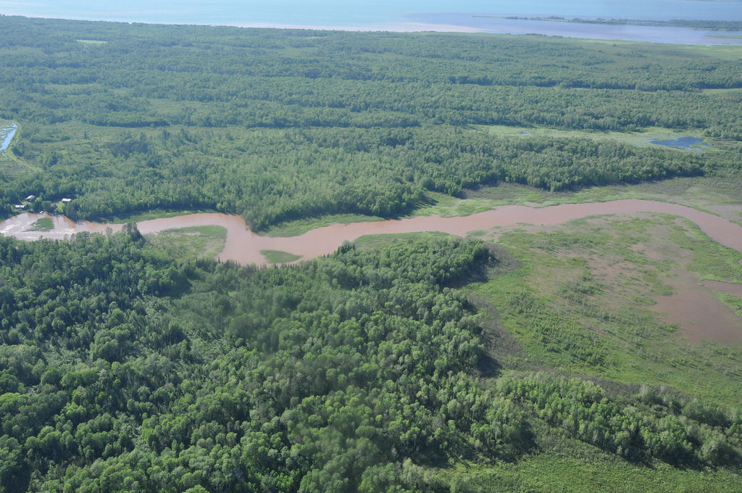
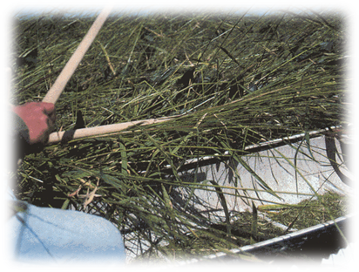
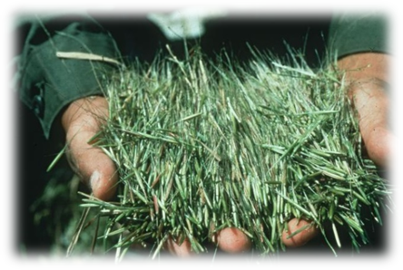
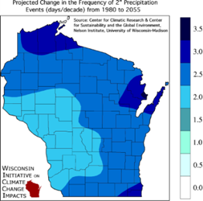
Example: Manoomin (Wild Rice)
Cultural Practice
Key Species
TEK, Place-based & Scientific Evidence
Increased Flooding
Requires shallow water, moderate water level changes, cool growing season
How will climate change affect the sustainability of manoomin?
What does this mean for cultural practices that rely on manoomin?
Projected frequency of 2”+ rain events,
1980-2055

Slide 24
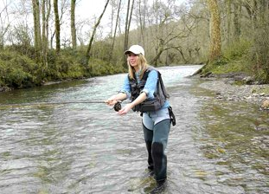
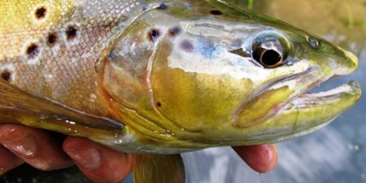
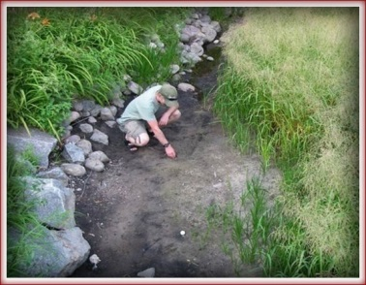
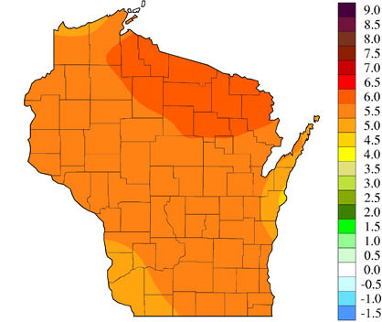
Key Species/Habitat
Place-based and Scientific Evidence
Cultural Practice
Requires cold water habitats with high oxygen levels
Projected change in Wisconsin’s annual average summer temperatures in ºF, 1980-2055
Climate models predict up to 95% of brook trout habitat across Wisconsin could be lost if the average annual summer air temperature increased just over 5 º F.

Slide 25
Cultural Practice
Key Species
TEK, Place-based and Scientific Evidence
Can thrive in warmer water habitats
Requires cool water habitats
As water temperatures get warmer, many Wisconsin lakes that currently can support natural walleye reproduction are unlikely to continue to have the thermal habitat conditions to do so.
Projected change in Wisconsin’s annual average summer temperatures in ºF, 1980-2055

Slide 26
Cultural Practice
Key Species
TEK, Place-based, and Scientific Evidence
Highly adaptable to a variety of habitat types, need for winter shelter to reduce energy loss
Projected change in frequency of nights below 0 ºF, 1980-2055
What limiting factors influenced by climate change could affect Wisconsin’s white tail deer population?

Slide 27
6. The model can be applied to non-consumptive practices
Species
TEK, Place-based and Scientific Evidence
Requires snowy habitats for winter camouflage
How will climate change affect the
sustainability of Waabooz (Snowshoe Hare) in Wisconsin?
Projected change in Wisconsin’s winter average temperatures in ºF, 1980-2055

Slide 28
Cultural Practice
Key Species
Place-based and Scientific Evidence
Requires shorelines nesting sites with stable to moderate water level fluctuations. Warm temperatures increase black fly predation on chicks.
Projected Change in Summer Average Temperature (°F) from 1980 to 2055
Projected frequency of 2”+ rain events,
1980-2055
What is the future for the sustainability of this
iconic symbol of Wisconsin’s northwoods?
“By 2080, the loon is forecasted to lose 56 percent of its current summer range and 75 percent of its current winter range….it looks all but certain that Minnesota will lose its iconic loons in summer by the end of the century.”- Audubon’s climate model.

Slide 29
7. The model is transferable to other cultures and locations
Example from South Milwaukee
Cultural Practice
Key species/habitat
Place-based and Scientific Evidence
Wisconsin Friday Night Perch Fish Fry
Requires cool water. Warmer water also favors invasives that compete with Yellow Perch
Credit: GLERL. 10/2014

Slide 30
Example from Southern Florida
Example from Southern Florida
Example from Southern Florida
Key species/habitat
Place-based and Scientific Evidence
Cultural Practice
Large circles = 50 or more pythons captured
Hiking in the Everglades
Invasive Burmese python:
requires very warm, moist “tropical” habitats
Increase in 95+-degree day/year, 2041-2070.
What does a changing climate mean for the sustainability of this invasive species? How could this affect recreation, nature-based tourism economies?

Slide 31
8. The model can be applied to
“non-species” dependent cultural practice
Cultural Practice
Key “habitat”
Place-based and Scientific Evidence
What do these changes mean for species, businesses, and cultural practices that depend on cold and snow?
Projected change in Wisconsin’s winter average temperatures in ºF, 1980-2055

Slide 32
9. The model can be applied to economic practices
Key Species/Habitat
Economic Practice
Place-based & Scientific Evidence
Fewer cold nights = less frozen ground affecting harvest & transport of logs to market
Projected change in frequency of nights below 0 ºF, 1980-2055
"38 days of frozen ground lost since 1949. That's only 60 years and we've lost ... five weeks, almost six weeks. What does that mean for forest operations?“
-Eau Claire, WI Logger From: “Shorter winters chip away at northern logging season”, The Daily Climate, 2013

Slide 33
Place-based & Scientific Evidence
Key Species/Habitat
Economic Practice
Change in frost-free days 1958-2012 (USDA)
Warm temps, ideal 65-80 degrees F
Ample moisture
Projected Change in Summer Average Temperature (°F) from 1980 to 2055
“Northern Wisconsin agriculture, for example, is likely to benefit from climate change further into the future, due to its more northern location.”- NOAA/ U of Iowa
Notes:
Not all cultural practices are “losers” if changes in environmental variables (like temperature) favors the sustainability of a species a cultural practice the practice depends on. However, there may be other limiting factors, such as precipitation, that could offset .

Slide 34
By applying Interpretative Principles, the G-WOW Model
Links place-based and scientific evidence
Creates culturally relevant climate change messaging
Is transferrable across different cultures, locations

Slide 35
10. Our real purpose is Provocation
Why Use an Interpretive Model in
Science Communication?
Awareness Action

Slide 36
The G-WOW model builds awareness (the set up)….
…. for ACTION (the spike)

Slide 37
11. The model offers a culturally relevant way to take climate action– through culturally relevant communication
Use the G-WOW Model…..integrate place-based evidence of climate change that has cultural or economic significance to the audience
Speak to values that resonate with people
Listen observations of others… Tell your climate story
Stress opportunities climate change presents, not just doom
Learn more about effective climate science communication

Slide 38
12. Climate Science Communication is Important
“There is no survey or study showing “consensus” on any of the most important scientific issues in the climate change debate.”
- Heartland Institute-
Yale Climate Communication Research
http://climatecommunication.yale.edu/

Slide 39
67% of Wisconsin residents think climate change is happening,
yet only 33% discuss it occasionally with others- Yale Climate Communications, 2018

Slide 40
Is the G-WOW Model Effective for Communicating About Climate?
Based on survey of educators trained in using the G-WOW model
agree or strongly agree to:
An increase in personal climate literacy and teaching skills
Being more confident in teaching about climate change using the model
The model is transferable to their student populations despite location
All respondents use the model in some form
Source: Patty Carpenter, 2016 UMD Master Degree Thesis:
“G-WOW Changing Climate, Changing Culture Professional Development's Influence on Classroom Teachers”

Slide 41
Ojibwe Lifeways
Place-based evidence & TEK of climate impacts seasonal Ojibwe cultural practices and water
Talking Circle
Sharing service learning projects via an interactive blog
What Can We Do?
Taking action through climate service learning projects
Investigate the Science
Climate research from federal, state, and tribal sources
Online G-WOW Resources
www.g-wow.org

Slide 42
Learn More
July 8-12, 2019: Climate Strong! Educator Professional Development Institute
Location: Northern Great Lakes Visitor Center-Ashland, WI; the Apostle Island National Lakeshore, and Lake Superior Ojibwe tribal communities
https://fyi.extension.wisc.edu/nglvc/climate-strong/

Slide 43
Joe Rose, Bad River Tribal Elder
We invite you to use the G-WOW model to increase climate change awareness & action based on the
unique lifeways of your culture
www.g-wow.org

Slide 44
Miigwech ! (Thank you)
For more information, please contact
Cathy Techtmann-Environmental Outreach State Specialist
University of Wisconsin-Extension
715.561.2695
catherine.techtmann@ces.uwex.edu
http://fyi.uwex.edu/nglvc/

Slide 45
Communicating about Climate Using the G-WOW Model: Wild Ricing
Wild rice harvesting is important to the Lake Superior Ojibwe people for subsistence, spiritual, and ceremonial purposes
Wild rice harvesting depends on the sustainability of manoomin (wild rice)
The sustainability of manoomin depends on habitats with
shallow water
moderate water level fluctuations
cool growing season temperatures

Slide 46
PLACE-BASED QUALITATIVE EVIDENCE
Historic cancellations/disruptions in wild rice harvests
(2007-2012, 2016, 2018) based on TEK & place-based evidence
SCIENCE-BASED QUANTITATIVE EVIDENCE:
Projected change in climate variables affecting habitat conditions for wild rice survival
HEAT
DROUGHT
GUSHERS
Annual average temperatures in ºF,
Frequency of 90-degree days
Change in frequency of 2” + precip
Projected changes in climate variables 1980-2055 (A1B scenario)

Slide 47
Phenological Evidence in Wisconsin
during the past 60 Years…
Bird migration | Vegetation
Geese Arrival 29 days earlier | Baptista (Wild Indigo) first bloom 18 days earlier
Cardinal first song 22 days earlier | Butterfly weed first bloom 18 days earlier
Robin arrival 9 days earlier | Marsh milkweed first bloom 13 days earlier
Aldo Leopold
Nina Leopold
From 1950-2014, on average spring has occurred 12 days sooner than expected, fall has started 12 days later
Growing season lengthened by 5-20 days across the state,
with greatest change in NW Wisconsin

Slide 48
TEK observations tend to be qualitative…
observations from a single locale over a very long time period
tend to be from resource users themselves whose harvesting success is dependent on the quality and reliability of their ecological observations
Scientific observations tend to be quantitative…
made by a small group of professionals
often synchronic (at one point of time) data or simultaneous observations (many at one point of time)
from a wide range of sites
frequently lack the long-term perspective of TEK
-Robin Kimmerer, Weaving Traditional Ecological Knowledge into Biological Education: A Call to Action, 2002. BioScience 52: 432-438.

Slide 49
Key Species/Habitat
Place-based & Scientific Evidence
Cultural Practice
Requires cold spring nights for sap production and quality
Projected change in Wisconsin’s average Spring temperatures in ºF, 1980-2055
How could climate change affect the cultural
and economic practice of maple sugaring?

Slide 50
What About the Polar Vortex?
and
2018??
2014, 2015, 2016,
2014
Midwest near-record cold for the Midwest
Alaska warmest since records began in 1918
Globally: Hottest year on record
Highest CO2 Level = 398.6 ppm
2015
Record cold & snowfall for eastern cities
Alaska: record high temps for February
Hottest year on record
Highest CO2 level =
400 ppm
2016
Record cold and snow in Midwest
Alaska: warmest year on record
Hottest year on record
Highest CO2 levels = 409 ppm
2018- 2/2019
Record cold and snowfall in Midwest
Alaska: 2nd warmest year
4th warmest year on record
Highest CO2 Levels =
411 ppm (2/19)
The last four-year (2015–2018) and five-year (2014–2018) periods are the warmest four- and five-year stretches on record for the contiguous U.S.

Slide 51
What About the Polar Vortex?
and
2018??
2014, 2015, 2016,
2014
Midwest near-record cold for the Midwest
Alaska warmest since records began in 1918
Globally: Hottest year on record
Highest CO2 Level = 398.6 ppm
2015
Record cold & snowfall for eastern cities
Alaska: record high temps for February
Hottest year on record
Highest CO2 level =
400 ppm
2016
Record cold and snow in Midwest
Alaska: warmest year on record
Hottest year on record
Highest CO2 levels = 409 ppm
2018- 2/2019
Record cold and snowfall in Midwest
Alaska: 2nd warmest year
4th warmest year on record
Highest CO2 Levels =
411 ppm (2/19)
The last four-year (2015–2018) and five-year (2014–2018) periods are the warmest four- and five-year stretches on record for the contiguous U.S.

